Slide 1

Barnesville Public Schools, ISD 146
Public Hearing for Taxes Payable in 2025
December 16, 2024
Presented By:
Jodi samuelson,
Finance officer

Slide 2
Minnesota State Law Requirements
A Public Meeting…
Between November 25th & December 30th
At 6:00 PM or later
May be part of regularly scheduled meeting
Must allow for public comments
May adopt final levy at same meeting
…and Presentation of:
Current year budget
Proposed property tax levy
Notes:
Meeting can occur on the 25th!

Slide 3




Hearing Agenda
Background Information on School Funding
District’s Budget
District’s Proposed Tax Levy for Taxes Payable in 2025
Public Comments

Slide 4
MN Legislature Must Set Funding for
Minnesota Public Schools
Minnesota Constitution ARTICLE XIII
MISCELLANEOUS SUBJECTS
Section 1
“UNIFORM SYSTEM OF PUBLIC SCHOOLS. The stability of a republican form of government depending mainly upon the intelligence of the people, it is the duty of the legislature to establish a general and uniform system of public schools. The legislature shall make such provisions by taxation or otherwise as will secure a thorough and efficient system of public schools throughout the state.”

Slide 5
As a Result, Funding is Highly Regulated
State Sets:
  Formulas which determine revenue; most revenue based on specified amounts per pupil
  Tax policy for local schools
  Maximum authorized property tax levy
    Districts can levy less, but not more than amount authorized by state, unless approved by voters in November
State also authorizes school board to submit referendums for operating & capital needs to voters for approval

Slide 6
General Education Formula Allowance, 2003-25
  Since 2002-03, state General Education Revenue formula has not kept pace with inflation
  For Fiscal Year 2023-24, an increase of 4.00% or $275 over previous year was approved
  For Fiscal Year 2024-25, an increase of 2.00% or $143 over previous year was approved
Per-pupil allowance for Fiscal Year 2024-25 of $7,281 would need to increase by another $1,364 (18.7%) to have kept pace with inflation since 2002-03, resulting in an allowance of $8,645
Notes:
Basic General Education Formula Lags Inflation

Slide 7
Underfunding of Special Education
According to MN Department of Education (MDE):
FY 2023 costs of providing programs were underfunded statewide by $726 million
Even with recent funding, costs will be underfunded by $455 million statewide by FY 2027
Primary options to bridge funding gap are to cut regular program budgets or increase referendum revenue, most districts have done both

Slide 8

Budget Information
__________
School district budgets are divided into separate funds, based on purposes of revenue, as required by law.
Our District’s Funds:
  General
  Food Service
  Community Service
  Building Construction
  Debt Service
Because approval of school district budget lags certification of tax levy by six months, state requires only current year budget information be presented at this hearing. Fiscal Year
2025-26 budget will be adopted by School Board in June 2025.

Slide 10
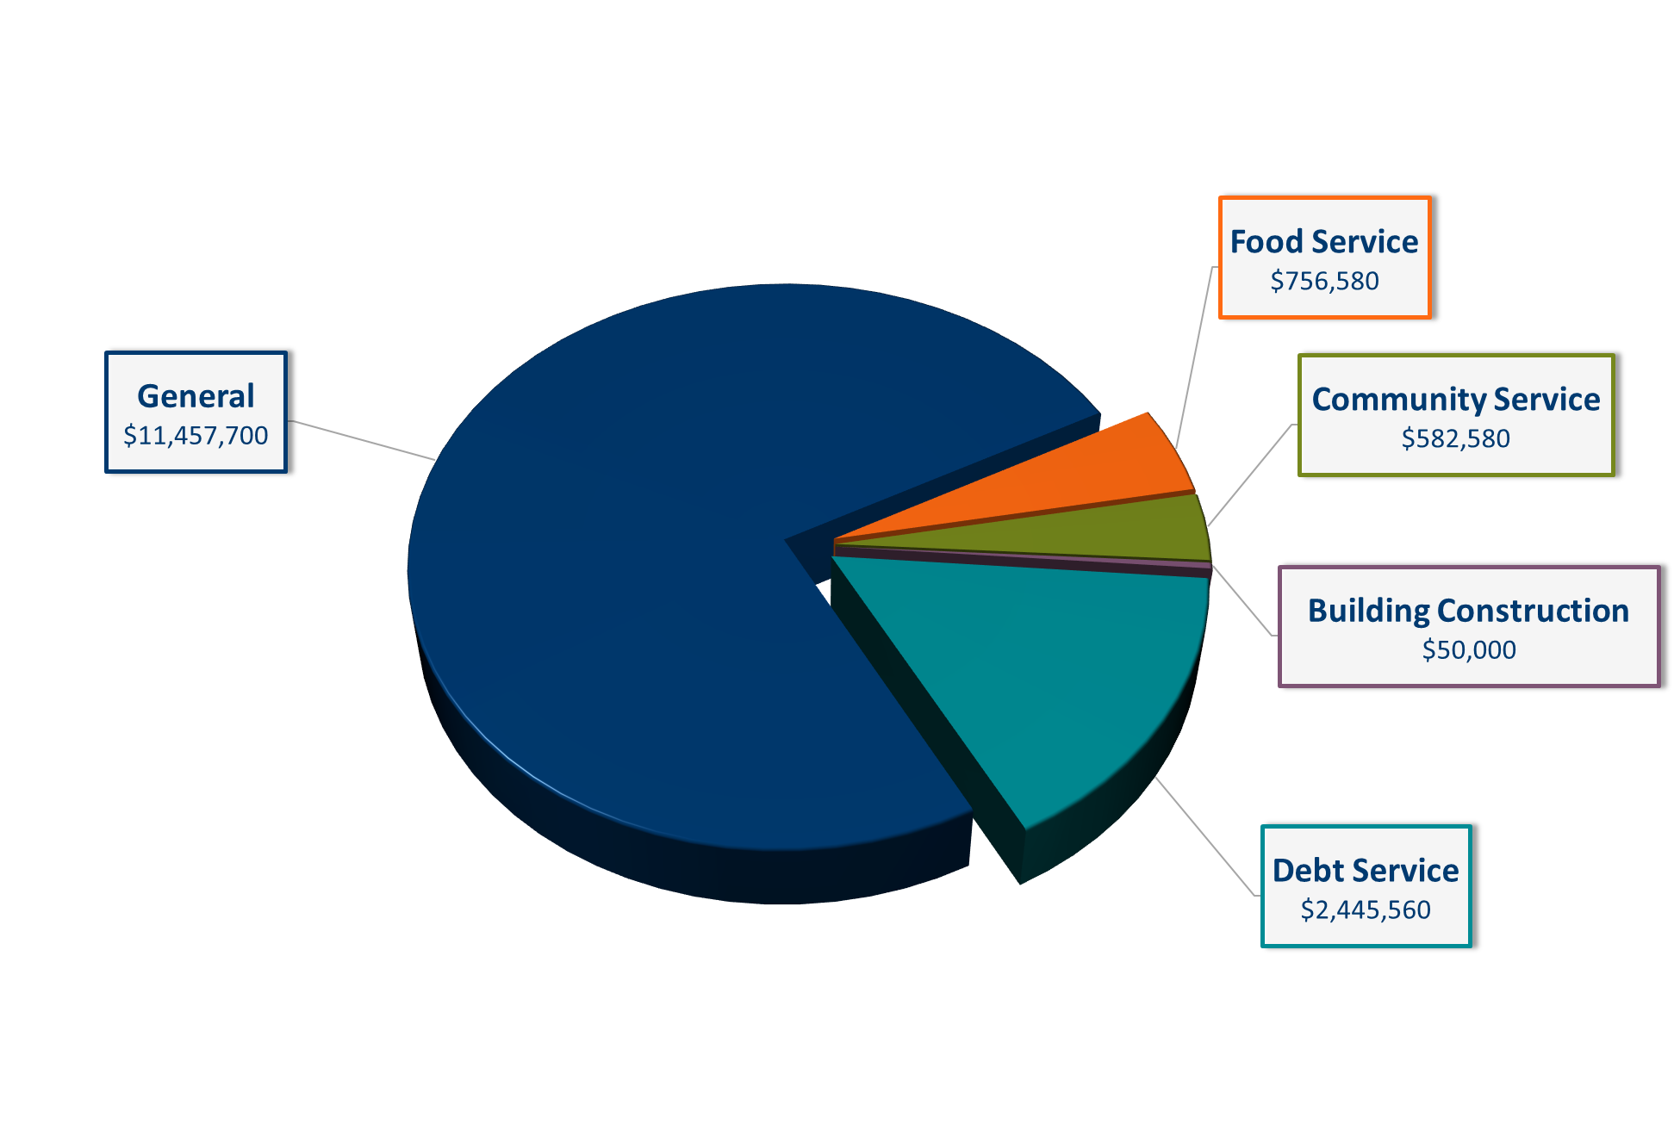
Revenue
- All Funds -
2024-25 Budget $15,292,420

Slide 11
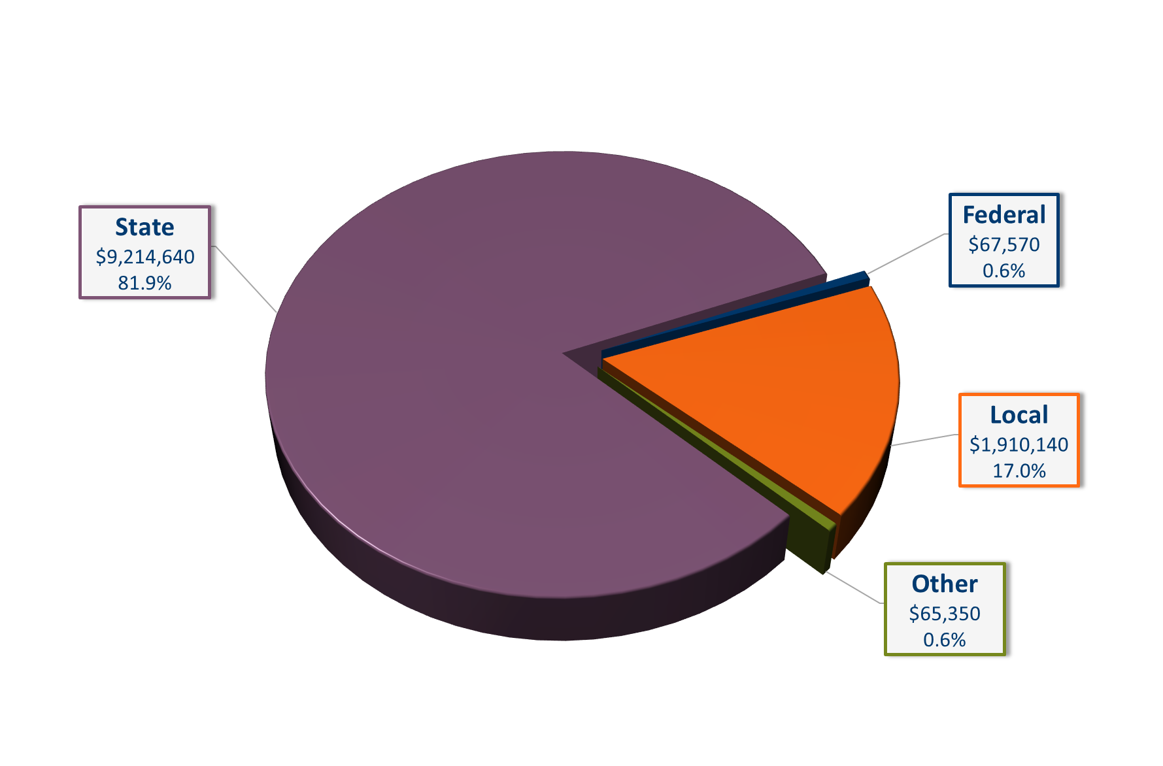
General Fund Revenue
2024-25 Budget $11,257,700

Slide 12
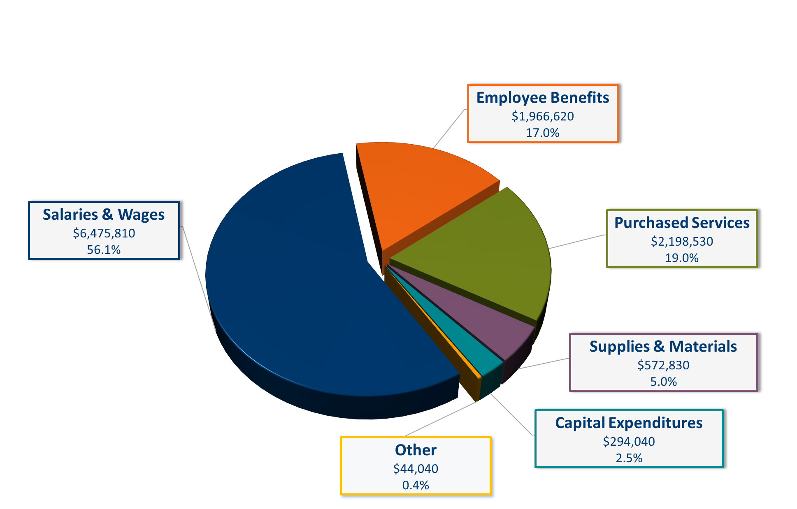
General Fund Expenditures
- by Object -
2024-25 Budget $11,551,870

Slide 13
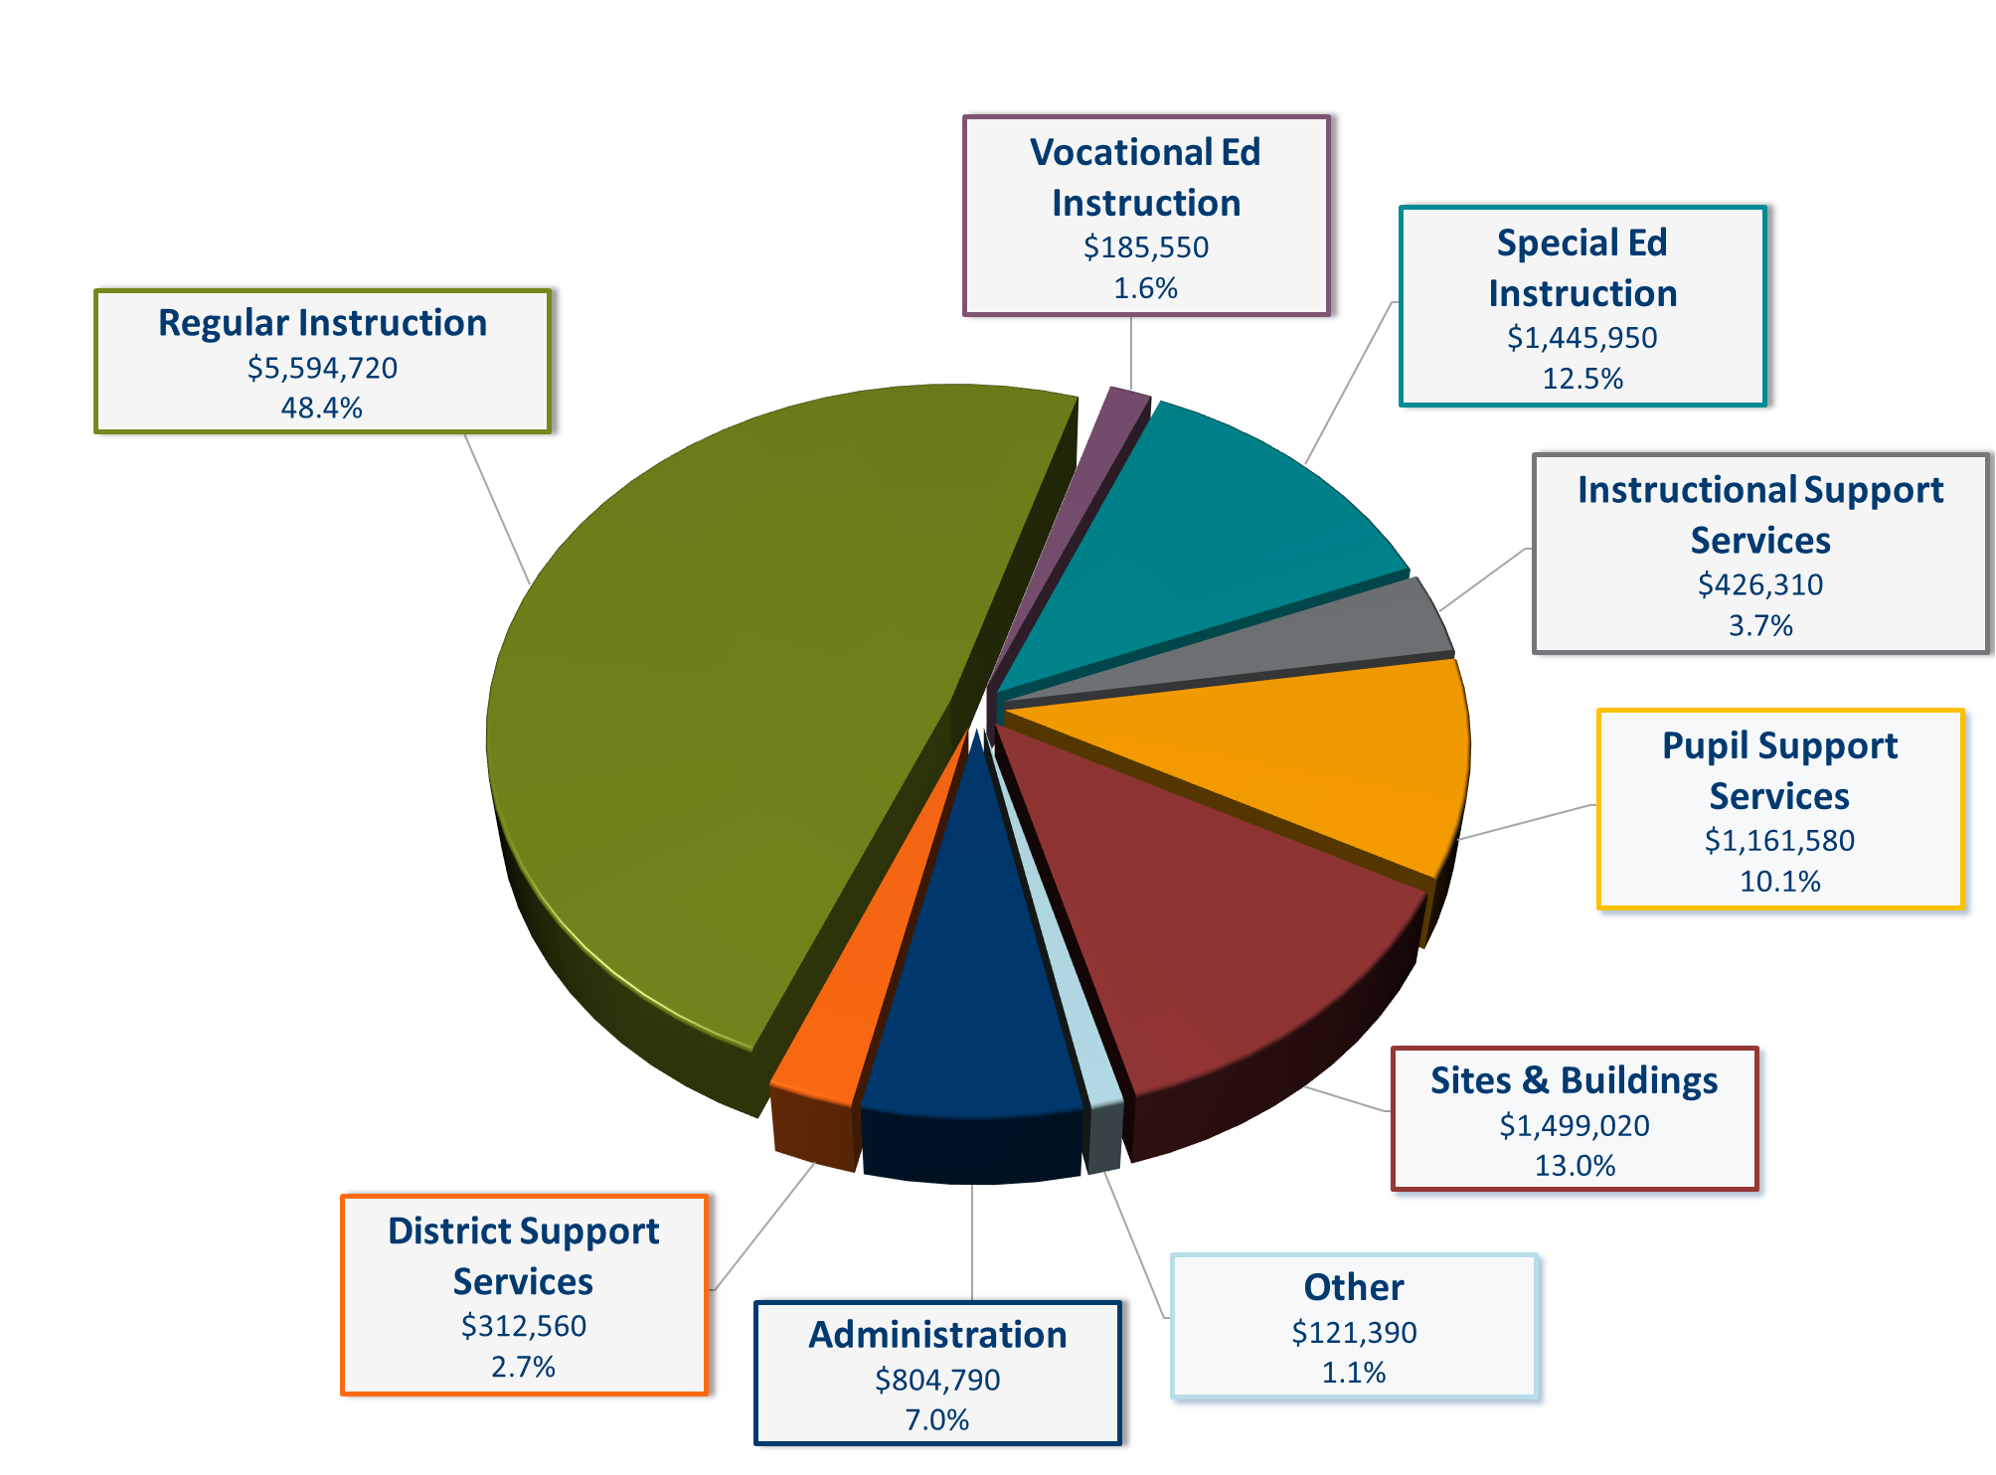
General Fund Expenditures
- by Program -
2024-25 Budget $11,551,870

Slide 14
Change in Tax Levy does not Determine
Change in Budget
Tax levy is based on many state-determined formulas plus voter approved referendums
Some increases in tax levies are revenue neutral, offset by reductions in state aid
Expenditure budget is limited by state-set revenue formulas, voter-approved levies & fund balance
An increase in school taxes does not always correlate to an equal increase in budget

Slide 15
Difference in Levy Cycles
School District:
Budget year begins July 1st
2025 taxes provide revenue for 2025-26 fiscal year
Budget adopted in June 2025
City/County:
Budget year begins January 1st
2025 taxes provide revenue for 2025 calendar year budget

Slide 16
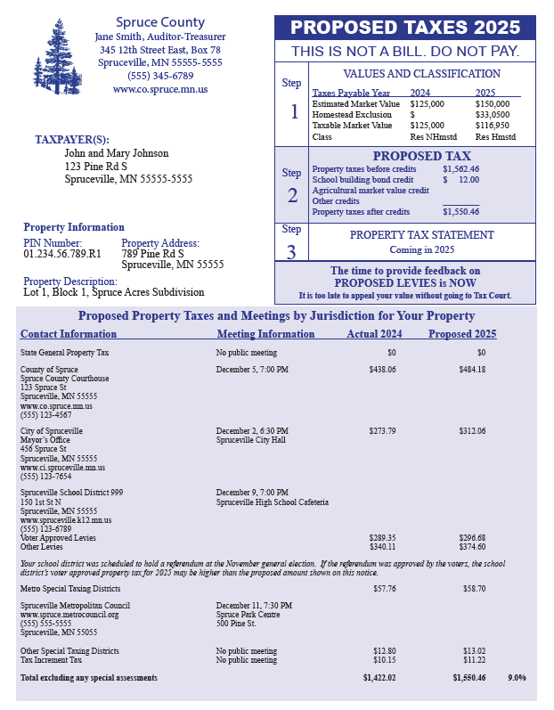
  Sample of parcel specific notice mailed to every property owner between November 10th – 25th
  Property Tax Background:
  Every owner of taxable property pays property taxes to various “taxing jurisdictions” (county, city/township, school district, special districts) in which property is located
  Each taxing jurisdiction sets own tax levy, often based on limits in state law
  County sends bills, collects taxes from property owners & distributes funds back to other taxing jurisdictions

Slide 17
School District Property Taxes
  Each school district has limited authority to levy taxes
  MDE calculates levy amounts for various categories, set by:
    State law
    Voter approval

Slide 18
School District Property Tax Process
__________
Step 1
City or County Assessor determines estimated market value for each parcel of property.
Step 2
Legislature sets formulas for tax capacity and school district levy limits.
Step 3
County Auditor calculates tax capacity for each parcel of property, as well as total tax capacity for each school district.
Step 4
Minnesota Department of Education calculates detailed levy limits for each school district, based on formulas approved by Legislature.
Step 5
School Board sets levy and is only one step in the process.
Step 6
County Auditor divides final levy by district’s total tax capacity to determine tax rate needed to raise levy amount.
Note: For certain levy categories, tax rates & levy amounts are based on referendum market value, rather than tax capacity.

Slide 19
Approval of District’s Tax Levy in 2024 (Payable 2025)
September 8: MDE prepared & distributed first draft of levy limit report setting maximum authorized levy
September 16: School Board approved proposed levy amounts
Mid-November: County mailed “Proposed Property Tax Statements” to all property owners
December 16: Public hearing on proposed levy at regular meeting
Following hearing, School Board will certify final levy amounts

Slide 20

Overview of District’s Proposed Tax Levy
  Proposed Payable 2025 tax levy is an increase from 2024 of $34,873 or 0.9%
  Changes by levy category and reasons for major increases & decreases in levy are included on following slides

Slide 22
Explanation of Levy Changes
Category:
General Fund – Local Optional Revenue (LOR)
Change:
+$51,287
Use of Funds:
General Operating Expenses
Reason for Change:
Revenue is provided through a combination of local tax levy and state aid; because District’s total property value increased, share of funding provided through tax levy increased
Notes:
*Duplicate slide if you need more explanation slides
-Right click in text box and select, “Edit Text”

Slide 23
Explanation of Levy Changes
Category:
General Fund – Operating Capital
Change:
+$22,794
Use of Funds:
Capital Expenses
Reason for Change:
Revenue is provided through a combination of local tax levy and state aid; because District’s total property value increased, share of funding provided through tax levy increased
Notes:
*Duplicate slide if you need more explanation slides
-Right click in text box and select, “Edit Text”

Slide 24
Explanation of Levy Changes
Category:
General Fund – Prior Year Adjustments
Change:
-$48,834
Use of Funds:
Various
Reason for Change:
Initial levies are based on estimates. In later years, amounts are updated and levies are retroactively adjusted.
Notes:
*Duplicate slide if you need more explanation slides
-Right click in text box and select, “Edit Text”

Slide 25
Explanation of Levy Changes
Category:
Total Debt Service Fund
Change:
-$34,968
Use of Funds:
Debt Payments
Reason for Change:
Debt service levies are coordinated to maintain a level or declining tax rate
Districts are required to levy at 105% of debt service payment amounts to cover delinquencies in tax collections
Because delinquencies are generally less than 5%, most districts gradually build up fund balances in debt service funds
Formulas in state law determine adjustments to tax levy for debt excess balances
Notes:
*Duplicate slide if you need more explanation slides
-Right click in text box and select, “Edit Text”

Slide 26
Factors Impacting Individual
Taxpayers’ School Taxes
Many factors can cause a tax bill for an individual property to increase or decrease from year to year
Changes in value of individual property
Changes in total value of all property within District
Increases or decreases in levy amounts caused by changes in state funding formulas, local needs & costs, voter-approved referendums & other factors

Slide 27
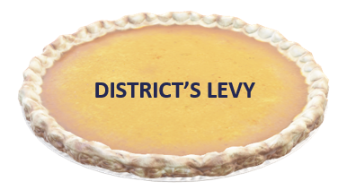

What’s happening with each slice?
Higher Market Value Increase = Bigger Slice
Lower Market Value Increase = Smaller Slice
Each Property Owner pays a portion of the pie

Slide 28

$100,000
Impact of Property Valuations
  Two properties in the district
    Both houses are valued at $100,000
  Total levy of $500
    Each property will pay $250 of levy
$100,000

Slide 29
$110,000
Impact of Property Valuations
  Two properties in the district
    Orange house value increases by 10%
    Blue house value increases by 25%
  Total levy of $500
    School District will still generate the same amount of levy even though values increased
    Orange house pays less
    Blue house pays more
$125,000

Slide 30
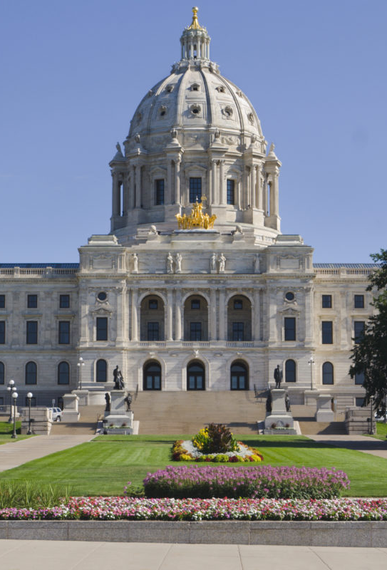
Minnesota Legislative Changes for Pay 2025
In 2023, The Minnesota State Legislature passed laws that affect property taxes for taxes payable in 2025.
Recap of major changes:
  Provided a tax benefit to homeowners by increasing the homestead exclusion for valuations between $76,000 and $517,000; and
  Increased the first-tier limit for Ag Homestead land to $3.5M from $2.15M

Slide 31
Four Year School Levy Comparison
  Examples include school district taxes only & are shown based on no change and a 25.8% increase in property value for residential homes over the past four years
    Actual changes in value may be more or less than this for any parcel of property
    Intended to provide a fair representation of what happened to school district property taxes over this period for typical properties
  Examples are for property in City of Barnesville
  Amounts for 2025 are preliminary estimates; final amounts could change slightly
  Estimates prepared by Ehlers (District’s municipal financial advisors)

Slide 33
Estimated Changes in School Property Taxes, 2022-25
Based on No Changes in Property Value

Slide 34
Estimated Changes in School Property Taxes, 2022-25
Based on No Changes in Property Value

Slide 35
Estimated Changes in School Property Taxes, 2022-25
Based on 25.8% Cumulative Changes in Property Value

Slide 36
State Property Tax Refunds & Deferral
Homestead Credit Refund
Available for all homestead property, both residential and agricultural (house, garage and one acre (HGA) only)
Refund is sliding scale, based on total property taxes and income (maximum refund is $3,310 for homeowners and $2,640 for renters)
Special Property Tax Refund
Available for all homestead property, both residential & agricultural (HGA only) with a gross tax increase of at least 12% and $100 over prior year
Refund is 60% of tax increase that exceeds greater of 12% or $100 (max $1,000)
Senior Citizen Property Tax Deferral
Allows people 65 years of age or older with household income of $96,000 or less to defer a portion of property taxes on their home
Deferred property taxes plus accrued interest must be paid when home is sold or homeowner(s) dies
36

Slide 37
Next Steps
Board accepts public comments on proposed levy
Board certifies 2025 property tax levy

Slide 38
Public comments

